Slide 1
Multiple-Character Optical Character Recognition
12.18.24
Nathaniel Liu, Chandler Nelson, Jakub Piwowarczyk

Slide 2
Introduction
Optical Character Recognition (OCR) attempts to process an image of some characters and match it to a predetermined list of symbols in an alphabet.
Requires the translation of analog world to digital information
The concept can be traced back to the late 1920’s, early 1930’s - updates in computational power made it possible nowadays
OCR is used in many technologies nowadays, from scanned document transcription to on-the-fly translation

Slide 3
Our Problem/Topic
Single Character OCR:
  Given a certain number of possible states, classify to the most likely one
Multiple Character OCR:
  Since letters/numbers are normally in strings, attempt to read the string together

Slide 4
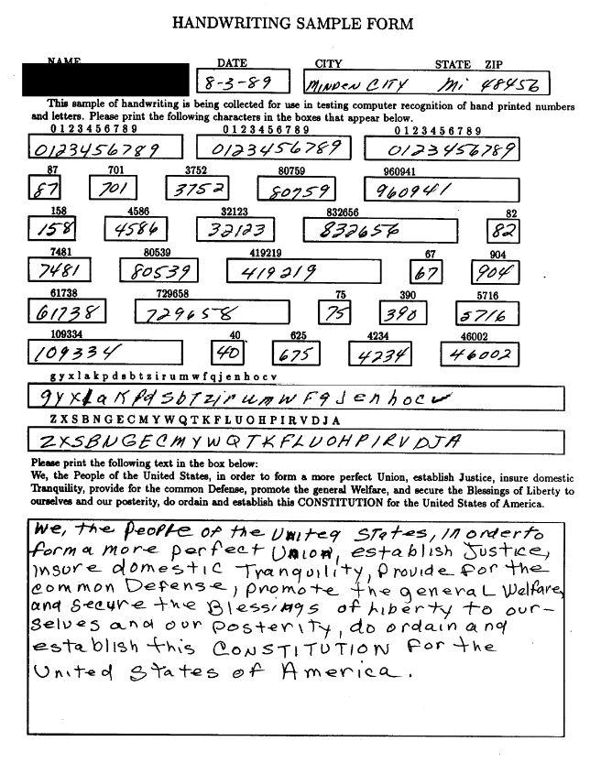
Dataset Overview
Special Database 19 contains NIST's comprehensive corpus of training materials for handwritten document and character recognition.
Key Features:
  Uppercase letters, lowercase letters, and number
  Sample forms collected from 3,600 writers.
  A total of 810,000 character images, each annotated with ground truth classifications.

Slide 5
Methodology: OCR Architecture (RF)
Features Utilized:
  Histogram of Oriented Gradients (HOGs)
    9 Directions
    8x8 pixels per cell
    2x2 cells per block
    L2-Hys Norm
    Gradients in a particular direction
  Hu Moments
    Invariant to shift and scale
Random Forest
  Trained with 100 Estimators
  Split Criterion: Gini
  Max features in single split: 8

Slide 6
Methodology: OCR Architecture (DL)
Model Architecture
  Input: 32×32 grayscale image.
    Resized, converted to grayscale and normalized
  CNN Feature Extractor:
    Conv1 (1,32,32 → 32,32,32), kernel size = 3, ReLU.
    Conv2 (32,32,32 → 64,32,32), kernel size = 3, ReLU, MaxPooling.
    FC1 (64*16*16 -> 128).
    FC2 (128 → 62).

Slide 7
Methodology: OCR Architecture (DL)
Model Architecture
  Input: 32×32 grayscale image.
    Resized, converted to grayscale and normalized
  CNN Feature Extractor:
    Conv1 (1 → 32), ReLU.
    Conv2 (32 → 64), ReLU, MaxPooling.
    FC1 (64*16*16 -> 128).
    FC2 (128 → 62).

Slide 8
Single-Character OCR (DL)
Hyperparameters
Dataset
Batch Size: 128
Number of Epochs: [10, 30, 50]
Learning Rate: [1e-3, 1e-4, 1e-5]
Optimizer: Adam
Loss Function: Cross Entropy
810,000 Samples
Each samples is a 32 x 32
0.8 Train Ratio
0.1 Validation Ratio
0.1 Test Ratio

Slide 9
Methodology: Multiple-Character OCR Architecture
LSTM Sequence Model:
  BiLSTM with 256hidden units and 2 layers.
Fully Connected Layer:
  Maps LSTM outputs to 62 output classes
CTC Loss:
  Aligns predicted sequences with ground truth labels.
Input: 32×256 grayscale image.
CNN Feature Extractor:
  Conv1 (1 → 64), BatchNorm, ReLU, MaxPooling.
  Conv2 (64 → 128), BatchNorm, ReLU, MaxPooling.

Slide 10
Multiple-Character OCR
Hyperparameters
Dataset
Batch Size: 64
Number of Epochs: 15
Optimizer: Adam
Learning Rate: 0.001
Loss Function: CTC Loss
50000 generated samples
Each samples is a 32 x 256
0.8 Train Ratio
0.1 Validation Ratio
0.1 Test Ratio

Slide 11
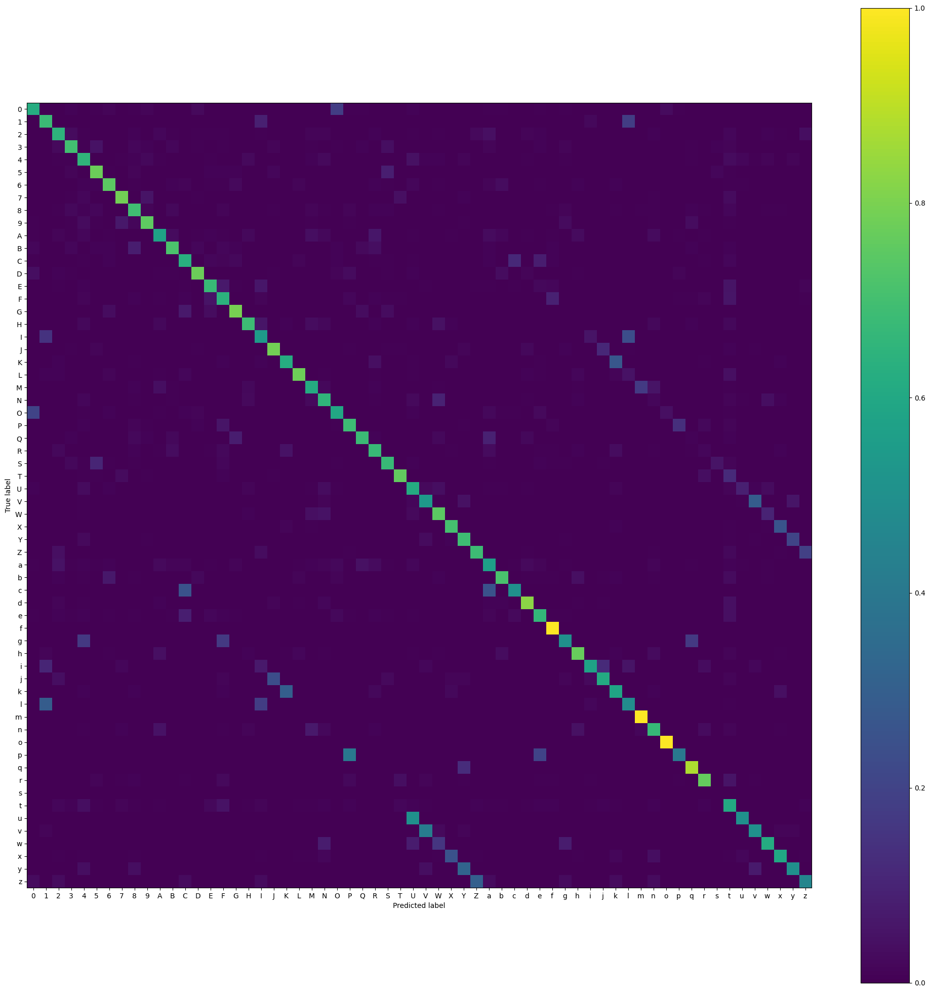
Results: Single-Character OCR (RF)
Testing Accuracy of 68.2%
Considerable confusion between some upper and lower case letters
Could not seem to get lower case “s” at all
Confusion Matrix of Random Forest Classifier

Slide 12
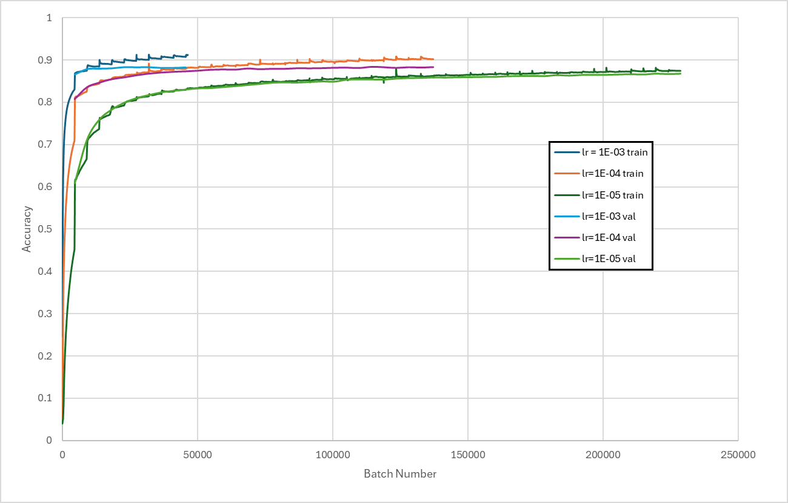
Results: Single-Character OCR (DL)
Graphs + desc underneath
Training and Validation Accuracy over 50 Epochs

Slide 13
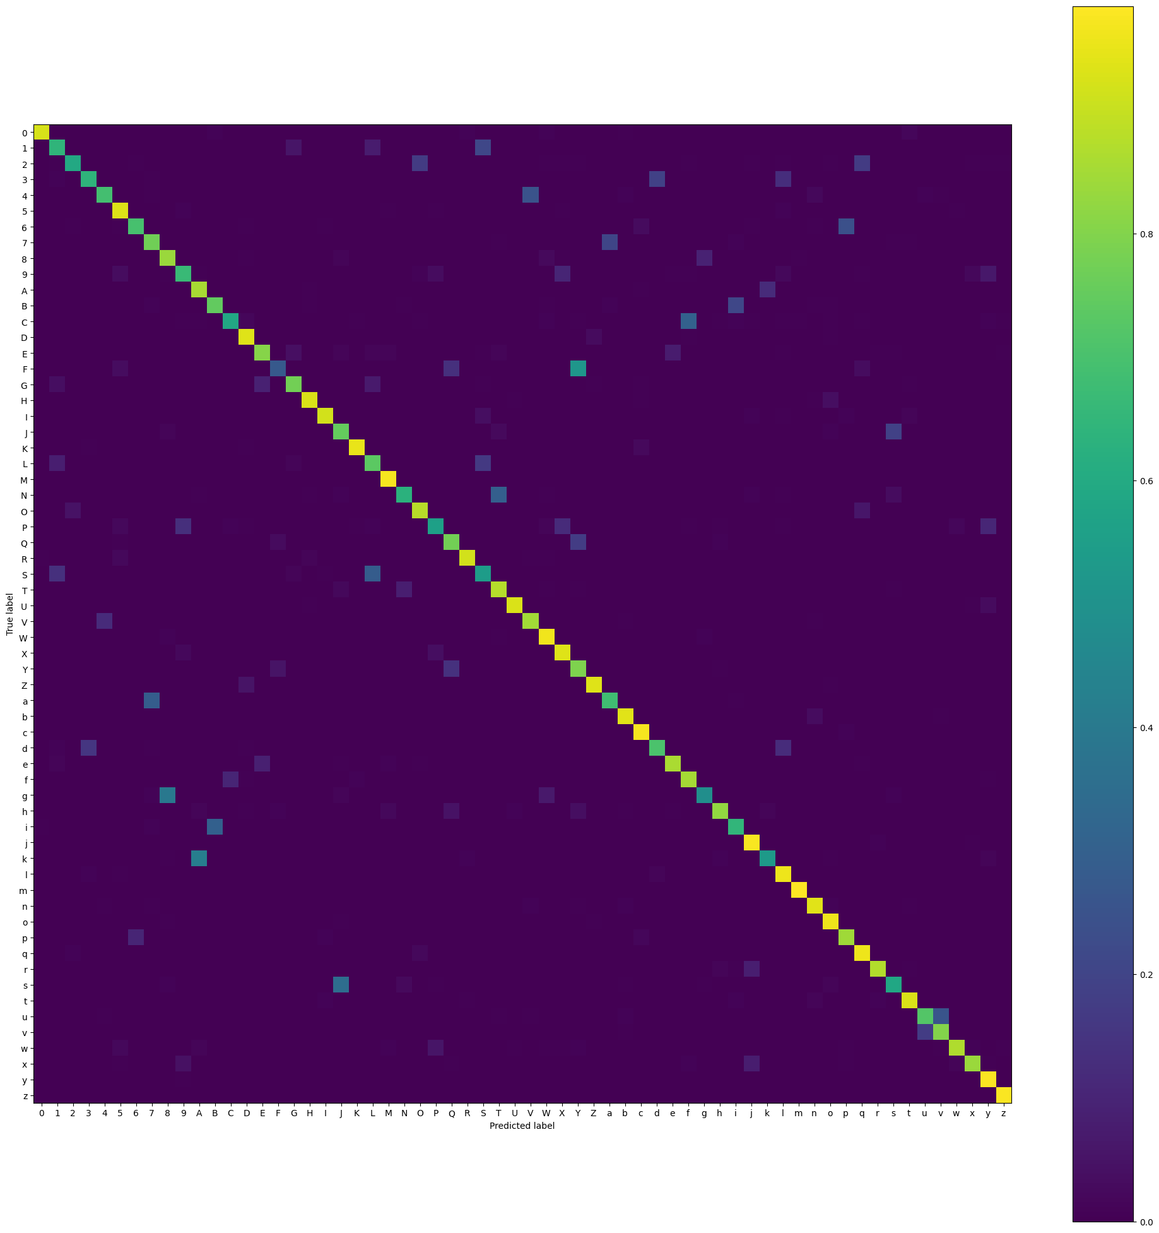
Results: Single-Character OCR (DL)
Testing Accuracy of 88.2%
Slight confusion with characters like “8” and “g”
Confusion Matrix of LR=1e-4 Network

Slide 14
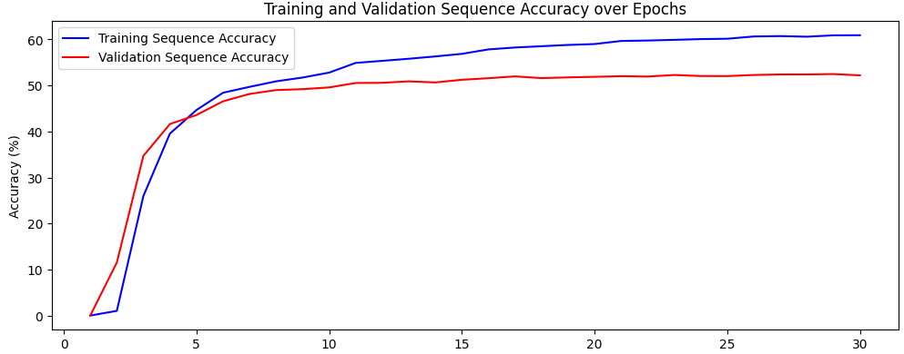
Results: Multiple-Character OCR
Training and Validation Sequence Accuracy over 30 Epochs

Slide 15
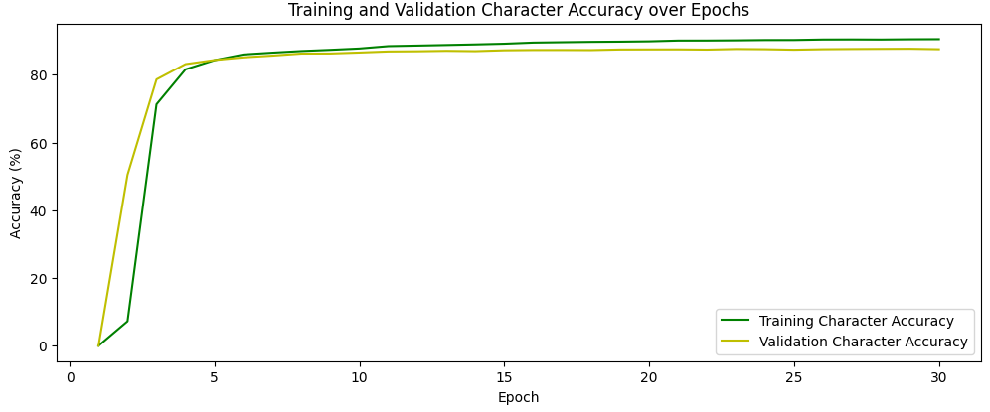
Results: Multiple-Character OCR
Training and Validation Character Accuracy over 30 Epochs

Slide 16
Additional Results: Multiple-Character OCR
On the test set, the model scored 87.76% character accuracy, but only a sequence accuracy of 52.88%.

Slide 17
Implications/Interpretation
Single-Character OCR
  Random Forest model does not perform as well as Deep-Learned model
    Likely due to scale invariance in Hu Moments
  Deep-Learned model performed quite well, additional data augmentation and context in word may push performance further
Multiple-Character OCR
  Model is able to learn character-level predictions and achieves relatively strong performance for multi-character sequences.
  The lower sequence accuracy suggests challenges in modeling dependencies across longer sequences.

Slide 18
Challenges
Limited computing resources.
Dataset lacked characters in sequences, had to generate synthetic dataset for multiple character OCR.
Difficulties getting Multiple-Character OCR to achieve higher sequence accuracy.

Slide 19
Future Work
Investigate dataset augmentation and more intelligent loss functions
Next steps would be to train the Multiple Character OCR on data more representative of how people write in real life
Explore transformer-based architectures
Try with more complex alphabets

Slide 20
Sources
Shunji Mori, Ching Y. Suen, and Kazuhiko Yamamoto, "Historical review of OCR research and development," Proceedings of the IEEE, vol. 80, no. 7, pp. 1029-1057, July 1992. Available: https://doi.org/10.1109/5.156468.
Lawrence O'Gorman, "The document spectrum for page layout analysis," Proceedings of SPIE - The International Society for Optical Engineering, vol. 2422, pp. 6-16, 1995. Available: https://doi.org/10.1117/12.373511.
National Institute of Standards and Technology, "NIST Special Database 19," [Online]. Available: http://doi.org/10.18434/T4H01C.
M. Marjani, M. Mahdianpari, and F. Mohammadimanesh, "CNN-BiLSTM: A Novel Deep Learning Model for Near-Real-Time Daily Wildfire Spread Prediction," Remote Sensing, vol. 16, no. 8, p. 1467, 2024. Available: https://doi.org/10.3390/rs16081467.
A. Graves, S. Fernández, F. Gomez, and J. Schmidhuber, "Connectionist Temporal Classification: Labelling Unsegmented Sequence Data with Recurrent Neural Networks," Proceedings of the 23rd International Conference on Machine Learning, Pittsburgh, PA, USA, pp. 369-376, June 2006. Available: https://www.cs.toronto.edu/~graves/icml_2006.pdf.

Slide 21
Thank You

